Slide 1
Deep Dive into native Universal App development with the Office 365 APIs
Speaker name
Title
Microsoft Corporation

Slide 2

Agenda
Introduction
Universal App projects
Integrating Office 365 APIs

Slide 3
Introduction

Slide 4
Universal Windows Apps
Announced at //build/ 2014
Three major goals
Reach customers across phones, tablets and PCs
Deliver innovation that supports developer investments
Make cross-platform technology easier and more capable
Delivered in Visual Studio 2013 Update 2

Slide 5
Universal App Project

Slide 6
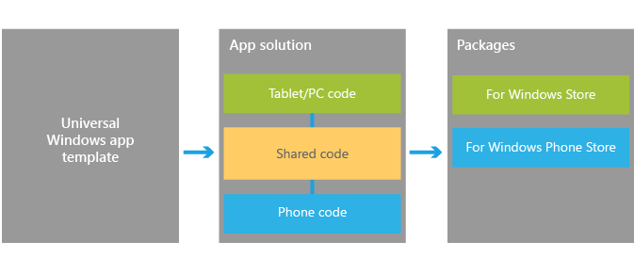
Visual Studio support
Windows App Certification Kit
Project template
Notes:
https://dev.windows.com/en-us/develop/Building-universal-Windows-apps
The Windows App Certification Kit has been extended to Phone apps. This allows a universal app to be in both Stores

Slide 7
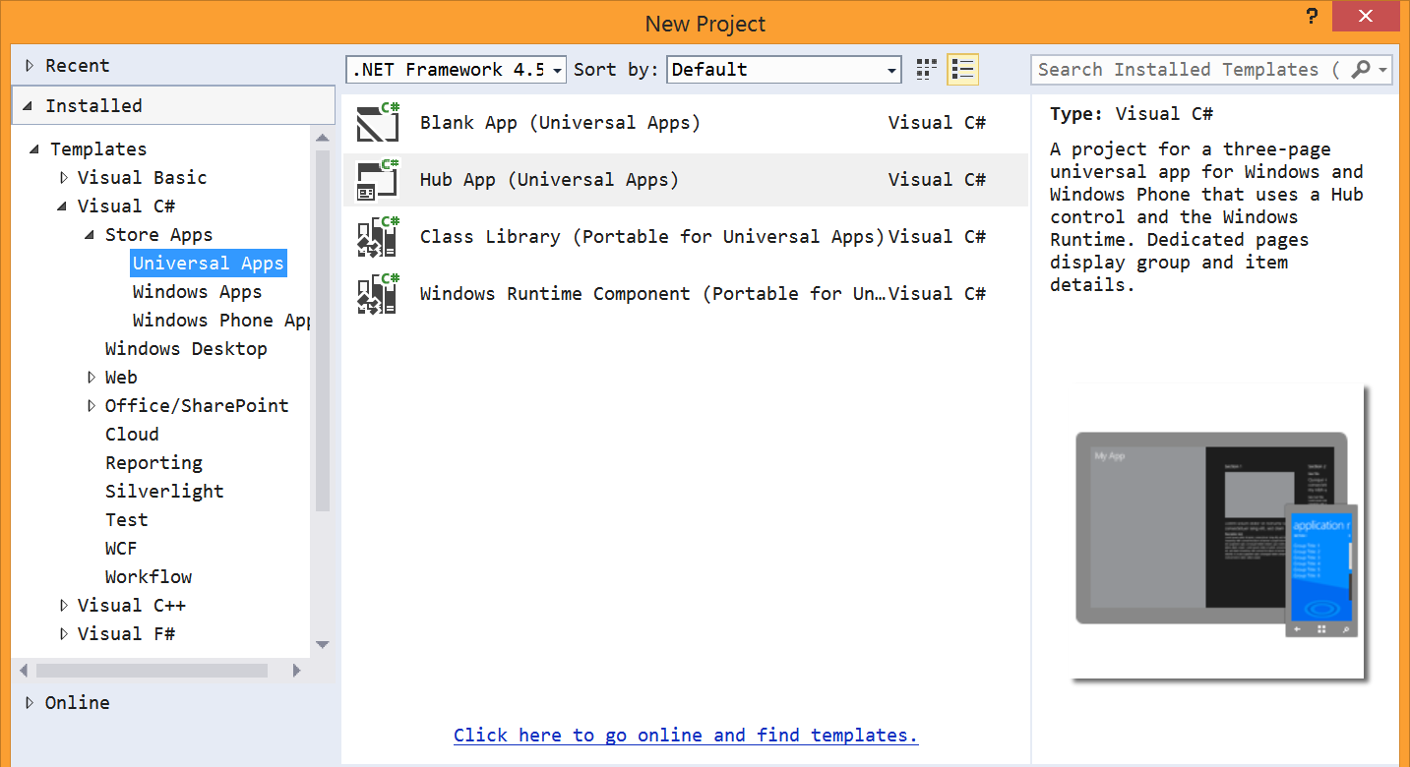
Universal App project template

Slide 8
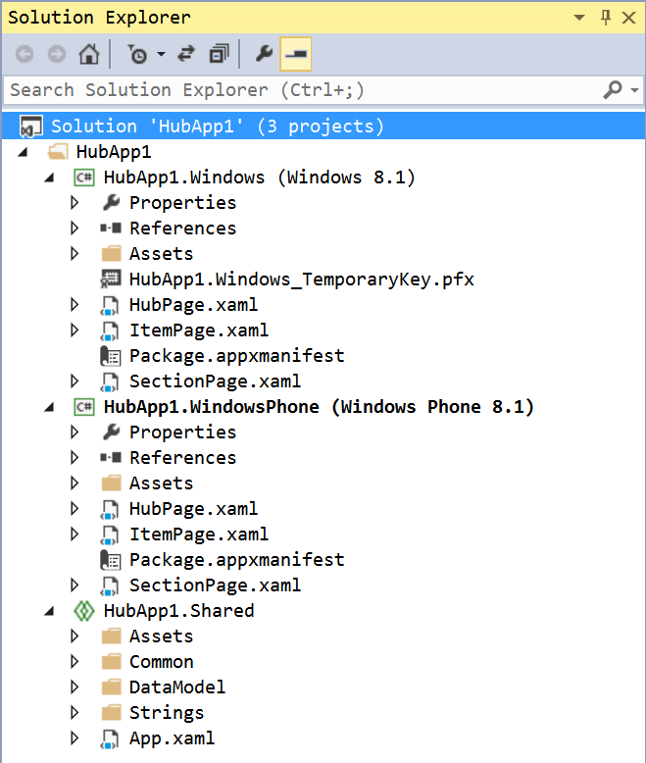
Universal App project template
Solution contains three projects
Windows
Phone
Shared
Shared is a special project type
File type is “shproj”
Does not contain references
Does not build

Slide 9
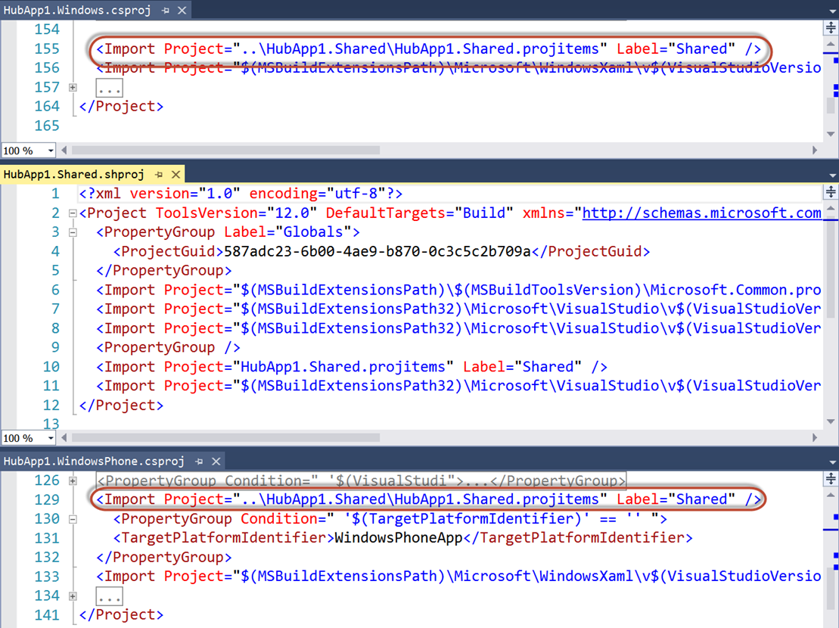
Universal App project template
Shared items imported into other projects
Compile-time constants
#if WINDOWS_APP
#endif
#if WINDOWS_PHONE_APP
#endif

Slide 10
Universal App project template
Contains sample data in Shared project
SampleData.json
Phone app is completely data-bound
Windows app only binds “Section 3”

Slide 11
demo
Universal App template
Notes:
Create a new HubApp project. Show the sample data and datasource
Right-click on windows app, set as startup project. Then open code-behind of HubPage and show the NavigationHelper_LoadState method. Point out the call to the sample data source. Run the project (F5)
Right-click on phone app, set as startup project. Again, show code behind of HubPage, pointing out the similarities. The same method loads the same sample data. Run the project (F5)

Slide 12
Integrating Office 365

Slide 13
Add Office 365 to Universal App
Add Connected Service
Need to add to both Windows and Phone projects
As of September 2014, Office 365 libraries not compatible for Phone projects
Create a data source
XAML makes heavy use of data binding, embrace that paradigm
Stateful client
Initiate login/consent and store Discovery Context

Slide 14
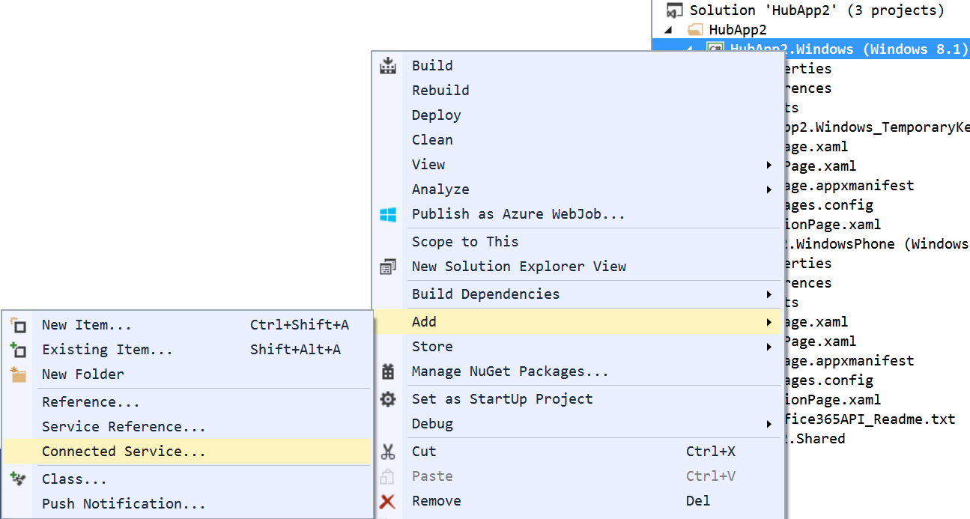
Add Connected Service

Slide 15
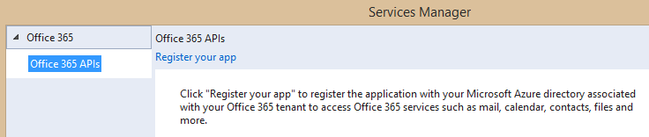
Adding Connected Services
1
Project > Add > Connected Service…
2
Register your app

Slide 16
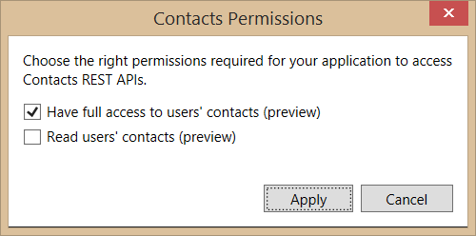
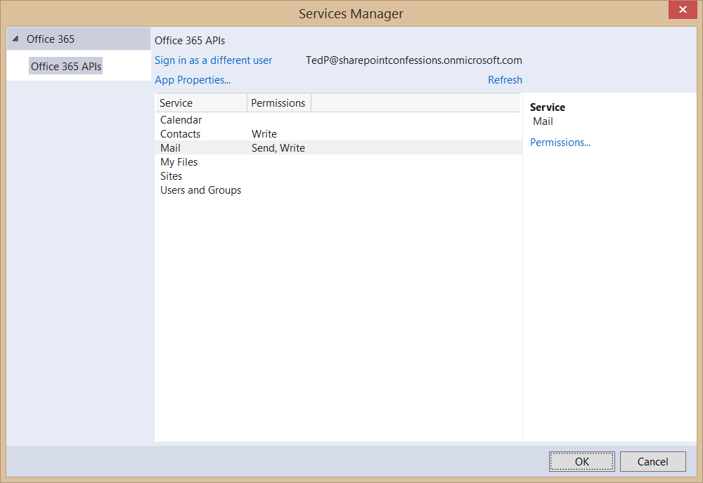
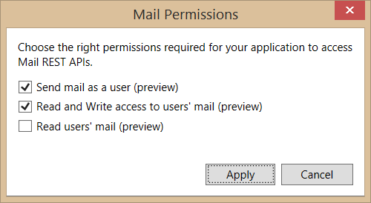
Connected Services Permissions
3
Select required app permissions

Slide 17
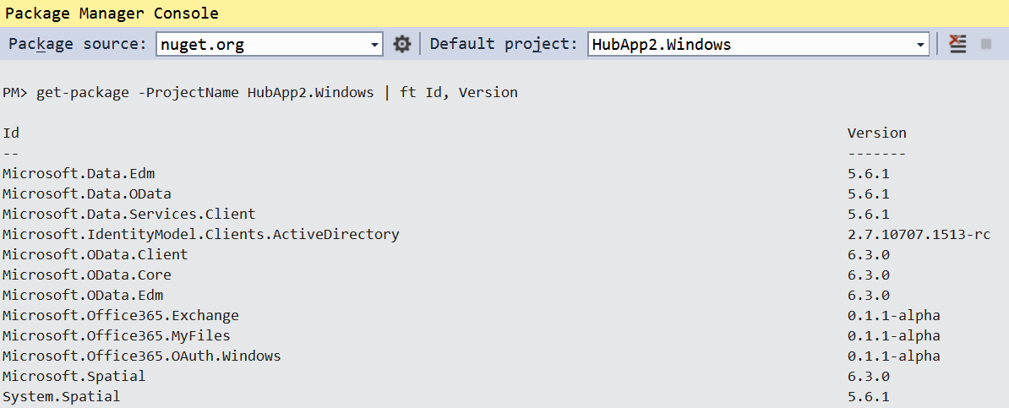
Add Connected Service
Installs NuGet Packages for Office 365 and dependencies

Slide 18
OAuth Implementation
Web-based apps use passive authentication
Accomplished via browser redirects
Universal Apps use active authentication
App code (or library code) initiates call to authentication source
The “Connected Service” wizard adds the appropriate library
Microsoft.Office365.OAuth.Web.dll for web projects
Microsoft.Office365.OAuth.WindowsStore.dll for native projects

Slide 19
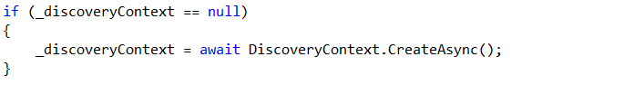
Authentication in O365 API Libraries
How it works
Create a DiscoveryContext
DiscoveryContext will invoke WebAuthenticationBroker (WAB)
WAB will display logon form and common consent form

Slide 20
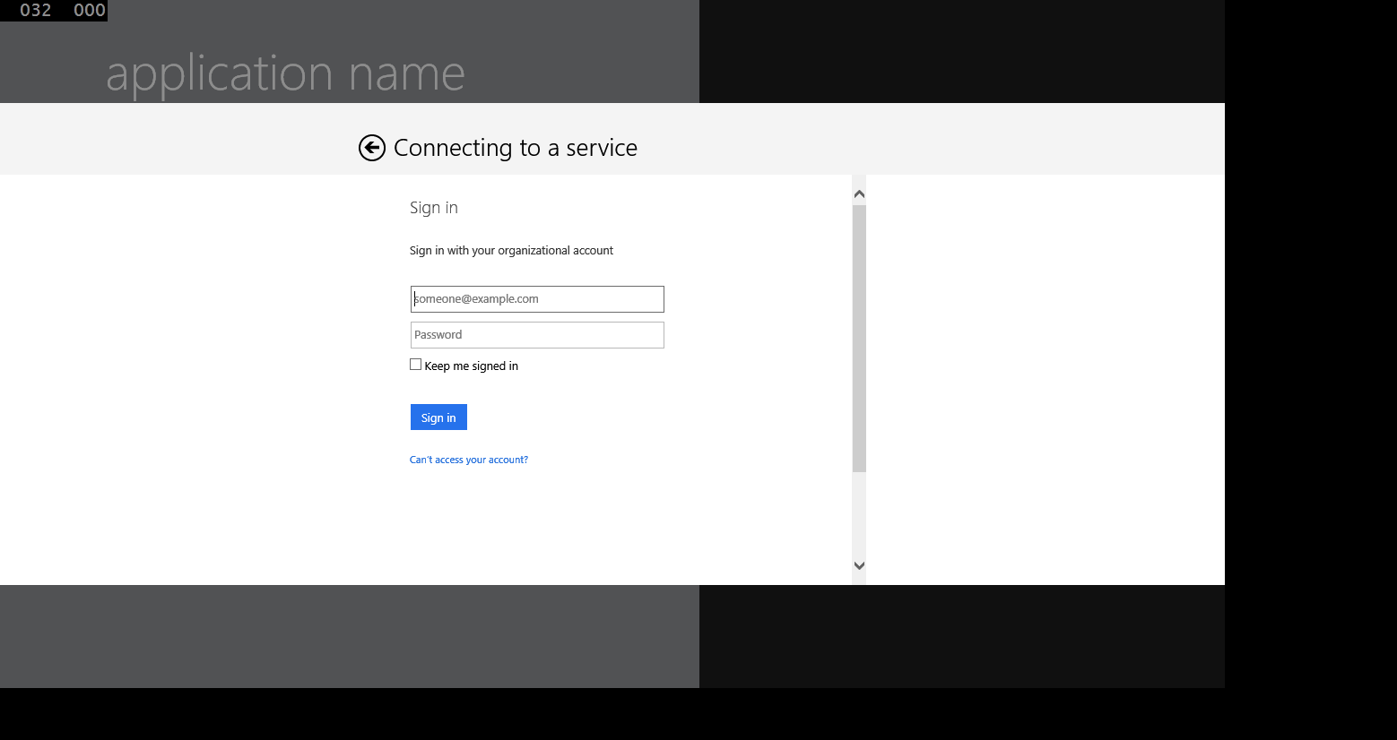
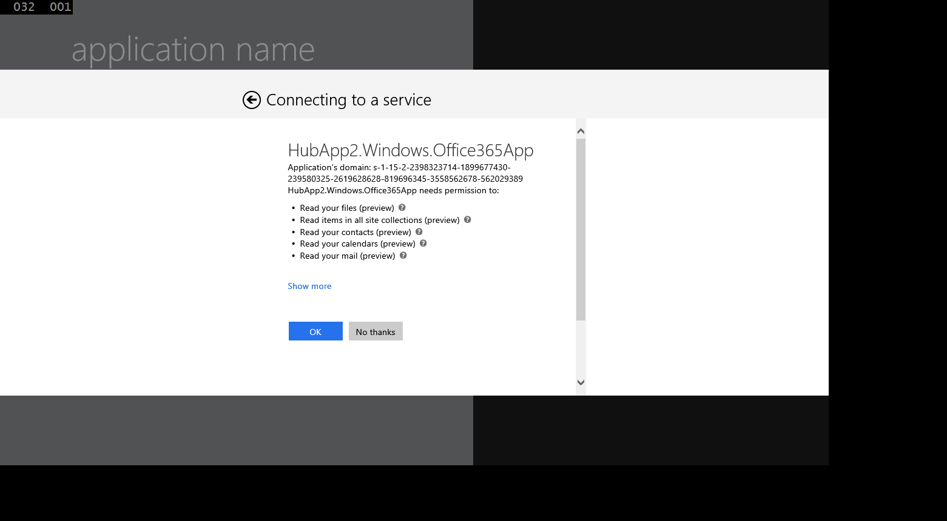
Authentication UI

Slide 21
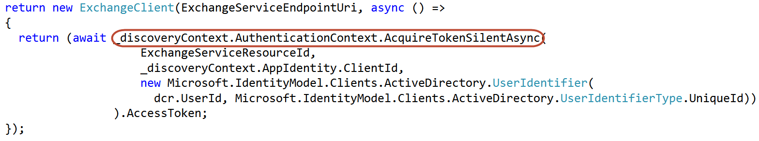
Office 365 Service Communication
“Client” objects for each service
ExchangeClient
SharePointClient
Constructor takes a “token getter” function
DiscoveryContext wraps an AuthenticationContext
AuthenticationContext has methods for getting tokens

Slide 22
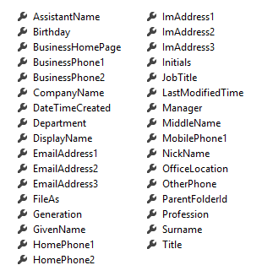
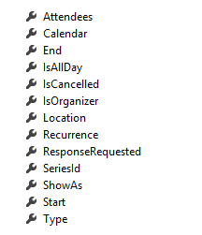
Office 365 Service Communication
Client Object exposes properties
Most are IEnumerable<T> collections
Designed much like Entity Framework
Client == DataContext
IEnumerable<T> entities
Includes common CRUD operations
Contact
Event

Slide 23

© 2012 Microsoft Corporation. All rights reserved. Microsoft, Windows, and other product names are or may be registered trademarks and/or trademarks in the U.S. and/or other countries.
The information herein is for informational purposes only and represents the current view of Microsoft Corporation as of the date of this presentation. Because Microsoft must respond to changing market conditions, it should not be interpreted to be a commitment on the part of Microsoft, and Microsoft cannot guarantee the accuracy of any information provided after the date of this presentation. MICROSOFT MAKES NO WARRANTIES, EXPRESS, IMPLIED OR STATUTORY, AS TO THE INFORMATION IN THIS PRESENTATION.

